Slide 1



GO Virginia Region 8
Talent Pathways Initiative
GO Virginia Region 8 Council Meeting
Tuesday, July 22, 2025, 10:00 AM
Summary of Report Items
Actionable Recommendations and Funding Priorities
Other Report Contents
Questions

Slide 2

GO Virginia Region 8
Talent Pathways Initiative
Report Contents
Actionable Recommendations
Situational Analysis
  Labor Demand
  Labor Supply
  Gap Analysis
  Key Findings
  Education and Training Asset Map
  Used both quantitative and qualitative methods
  Extensive research and citations
This Photo by Unknown Author is licensed under CC BY-SA

Slide 3
GO Virginia Region 8
Talent Pathways Initiative
Actionable Recommendations & Funding Priorities
Five main challenges exist that these recommendations are designed to address:
An overall shortage of workers for available jobs in Manufacturing and Transportation & Logistics.
An inability of employers to engage all sources of talent in the region, particularly non-college bound high school seniors, older workers or those who have not been in education programs, individuals with disabilities and neurodivergent people, and those who are long-term unemployed.
Opportunities to retain workers and promote longer term labor force attachment.
Worker shortcomings in using critical analysis or adaptability to changing job roles and tasks, new technology, or changing market conditions.
Deploying talent strategies on a regional and comprehensive basis rather than on a case by case basis.

Slide 4
GO Virginia Region 8
Talent Pathways Initiative
Actionable Recommendations Structure
Three Broad Funding Strategies:
Sector-Based Training and Partnerships
Education and Training Alignment
Engaging all Sources of Talent
  Summary
  Region 8 Challenge
  Particular Funding Strategy
  Deliverables for the Particular Funding Strategy

Slide 5
GO Virginia Region 8
Talent Pathways Initiative
Sector-Based Training and Partnerships
Sector Coordination, Communication, and Business Engagement
Career Pathways, Job Roles, and Career Mobility
Job Development and Labor Force Attachment
Industry and Education Instructor Model

Slide 6
GO Virginia Region 8
Talent Pathways Initiative
Education and Training Alignment
Work-Based Learning
Durable Skills Development

Slide 7
GO Virginia Region 8
Talent Pathways Initiative
Engaging All Sources of Talent
Expansion of Talent Pipeline
Community and Family Outreach and Industry Exposure

Slide 8

GO Virginia Region 8
Talent Pathways Initiative
Questions?

Slide 9

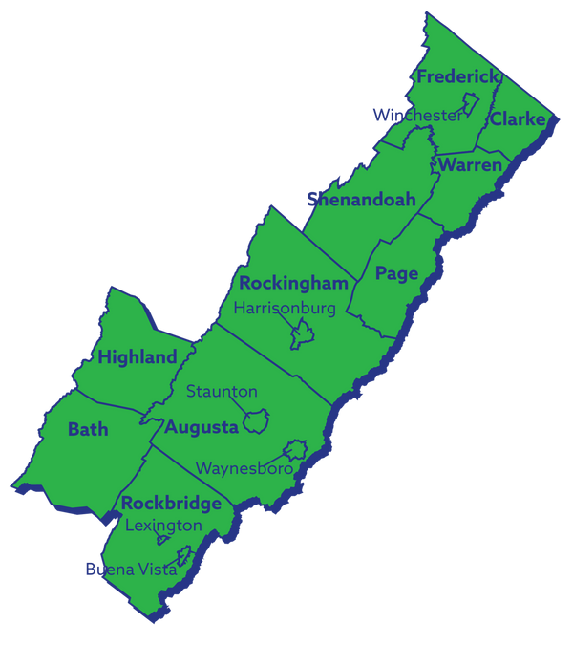
REGION 8
Economic Growth & Diversification Plan Update

Slide 10

GoVA Region 8 | 2025 Growth and Diversification Plan Full Review
Economic Growth and Diversification Plan Update
Stakeholder Engagement
Regional SWOT Analysis
Timeline & Next Steps

Slide 11
GoVA Region 8 | 2025 Growth and Diversification Plan Full Review
Regional SWOT Overview
Strengths
Strategic location along I-81, I-64, I-66 corridors
Opportunities
Expand workforce training collaborations
Strong educational partnerships
Diverse economic base and cross-sector growth
Redevelop underutilized properties
Build on health systems talent pipeline models
Capture student population with new opportunities
Regional broadband expansion (VATI grant)
Agricultural Heritage
High quality of life and lower cost of living
Weaknesses
Aging workforce (32.9% aged 55+)
Threats
Critical worker shortages across sectors
Youth outmigration to higher-wage areas
Below-average educational attainment
Limited incumbent worker training
Skills gap in "essential skills"
Housing affordability challenges
Dwindling # of available classified sites
Structural Barriers - Transportation, childcare, rural infrastructure gaps
Aging infrastructure constraints

Slide 12
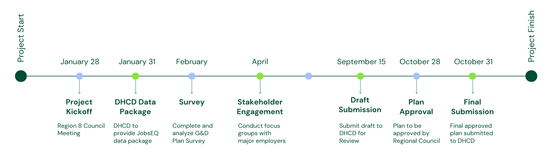
GoVA Region 8 | 2025 Growth and Diversification Plan Full Review
Plan Review Timeline & Next Steps

Slide 13

Director’s Report
Upcoming Events:
7/31 Virginia Intern Day (Harrisonburg)
8/1 BluePrint 2035 (Lexington)
9/9 GO Virginia State Board Mtg (Richmond)
9/15 G&D Plan Draft due to DHCD
9/17-19 VEDA Fall Conference (Harrisonburg)
9/19 Planning Grants due to DHCD
9/26 Per-Capita Grants due to R8 Exec. Dir.
Q3 Objectives:
Submit to DHCD Annual Reporting
Grant(s) State Board Approval – Sept.
Distribute TPI Report – Q&A R8 Virtual Mtg.
Complete G&D Plan – Oct.
Complete Website Improvement Plan
Develop Grant Application Submissions – Oct.
  Clarke Co. Extended Due Diligence
  TPI Implementation Project
Statewide AI Initiatives:
Virginia AI Landscape Assessment Survey
VA Chamber Foundation + GO Virginia
Complete by July 31st
www.VirginiaHasJobs.com/AI Career Launch Pad
Governor Press Release 7/15/25
In Partnership w/ Google: Available Scholorships
Google AI Essentials Courses
Google Career Certificates
Stay Connected:
Govirginiaregion8.org/Events
LinkedIn: @GO Virginia Region 8
Facebook: @GO Virginia Region 8
Instagram: @gova_r8
Email: alison@govirginiaregion8.org

