Slide 1

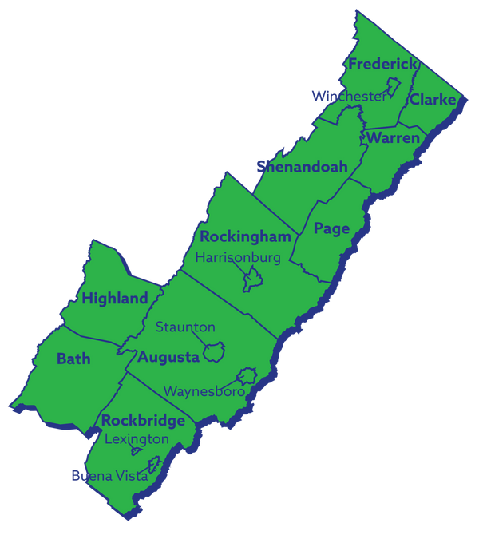
REGION 8
Economic Growth & Diversification Plan Update

Slide 2

GoVA Region 8 | 2025 Growth and Diversification Plan Full Review
Economic Growth and Diversification Plan Update
Stakeholder Engagement
Regional SWOT Analysis
Timeline & Next Steps

Slide 3
GoVA Region 8 | 2025 Growth and Diversification Plan Full Review
Regional SWOT Overview
Strengths
Strategic location along I-81, I-64, I-66 corridors
Opportunities
Expand workforce training collaborations
Strong educational partnerships
Diverse economic base and cross-sector growth
Redevelop underutilized properties
Build on health systems talent pipeline models
Capture student population with new opportunities
Regional broadband expansion (VATI grant)
Agricultural Heritage
High quality of life and lower cost of living
Weaknesses
Aging workforce (32.9% aged 55+)
Threats
Critical worker shortages across sectors
Youth outmigration to higher-wage areas
Below-average educational attainment
Limited incumbent worker training
Skills gap in "essential skills"
Housing affordability challenges
Dwindling # of available classified sites
Structural Barriers - Transportation, childcare, rural infrastructure gaps
Aging infrastructure constraints

Slide 4
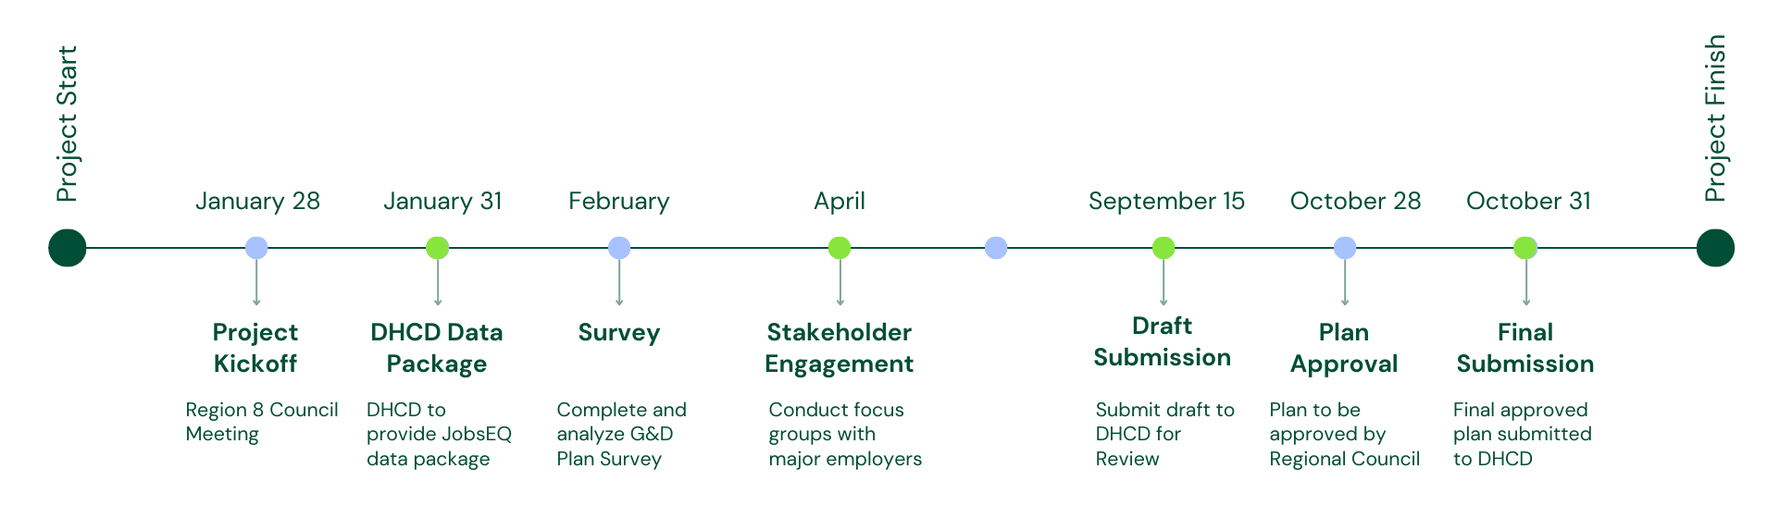
GoVA Region 8 | 2025 Growth and Diversification Plan Full Review
Plan Review Timeline & Next Steps

