Slide 1

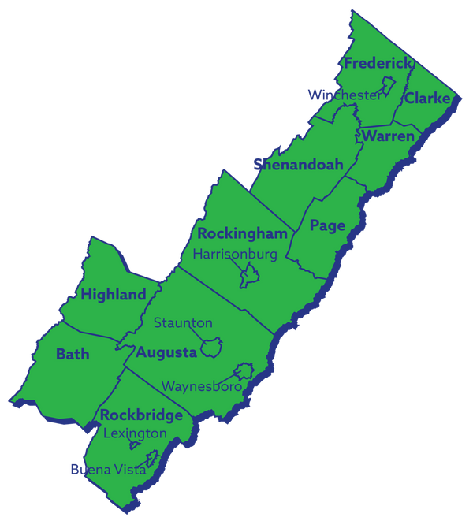
REGION 8
Economic Growth & Diversification Plan Update

Slide 2
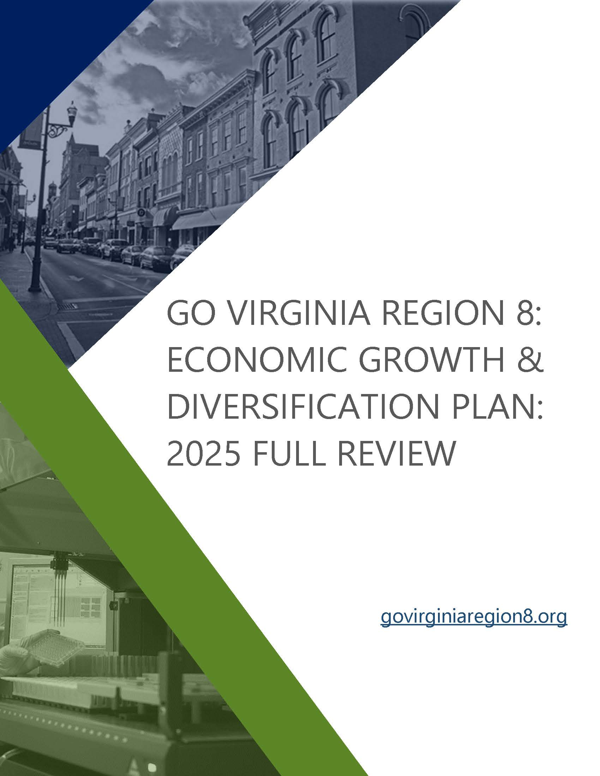
GOVA Region 8 | 2025 Growth and Diversification Plan Full Review
Economic Growth and Diversification Plan
Economic Performance
Skills Gap Analysis
Situational Analysis
Goals & Actionable Strategies

Slide 3
GOVA Region 8 | 2025 Growth and Diversification Plan Full Review
Key Updates
Refining Goals and Strategies
Amending Targeted Industries
Agriculture & Value-Added Food
Adding Skills Gap Analysis
Addressing new state requirement
Building on the Talent Pipeline Initiative (TPI)
Transportation & Logistics
Manufacturing
Life Sciences
IT & Emerging Technology
Incorporating TPI recommendations
Ensuring pipeline projects are supported

Slide 4
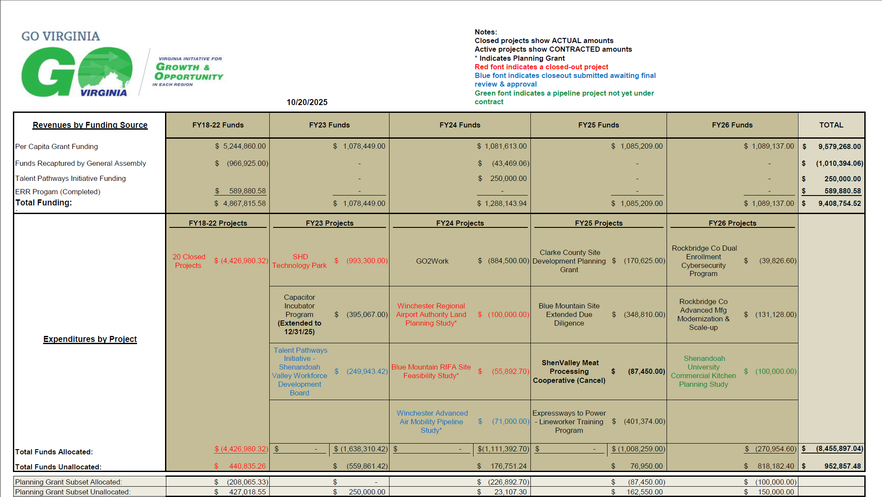

Slide 5
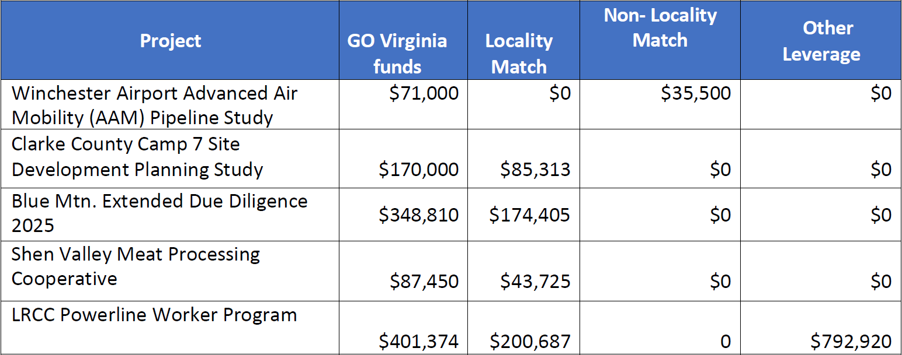
FY25 GoVaR8 Total Funded Projects $1,078,634

Slide 6
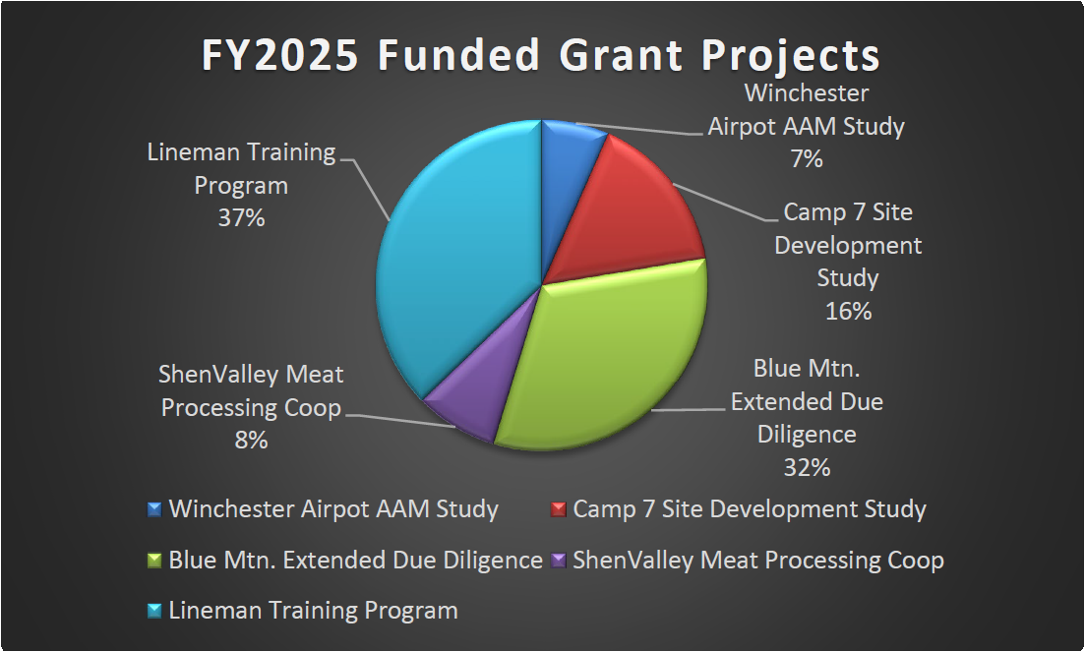

Slide 7

FY25 Upcoming Events/Meetings/Deadlines
October 29: Region 2 Economic Forum at VT
October 30: TPI Virtual Follow-up Meeting
October 31: G&D Plan Submission Deadline to DHCD
October 31: Grant Application Submission Deadline to DHCD
November 3: Valley Career & Technical Center Open House
November 5: GoVaR8 Social Event – JMU Men’s Basketball
Game
November 10th Week: Pitch Calls w/ DHCD & State Board Workgroup
November 17th Week: Grant Application Feedback Loop & Responses
November 20: DHCD Support Org Call
December 2: GoVaR8 Executive Committee Meeting
December 3: VA Innovation Accelerator Ribbon Cutting
December 4: VEDA Winter Conference (Richmond) – Legislative
December 5: VA State Chamber Conference (Richmond) – Legislative
December 9: Central Valley Legislative Chamber Breakfast
December 9: GO VA State Board Meeting
December 18: DHCD Support Org Call
December 19: January Grant Applications due to Executive Director
Now to End-of-Year Objectives:
Attend activities noted to left
Blue Ridge Technical Center Grant Application
Camp 7 Extended Due Diligence Grant Application
TPI Implementation Grant Application (SVWDB)
Bath & Highland County Initiatives
Competitive Grant Application Support:
  Regional Commercialization Innovation Network Project
  GoTec Implementation Initiative
  Discussions on Aviation Innovation Corridor w/ R2
Assist Executive Committee w/ council member nominations
Discuss/Confirm Website Improvement Initiatives
G&D Plan Follow-up Virtual Meeting (Schedule & Host)
Create/Distribute Calendar Invites for FY26
Enjoy the Holidays!!

Slide 8
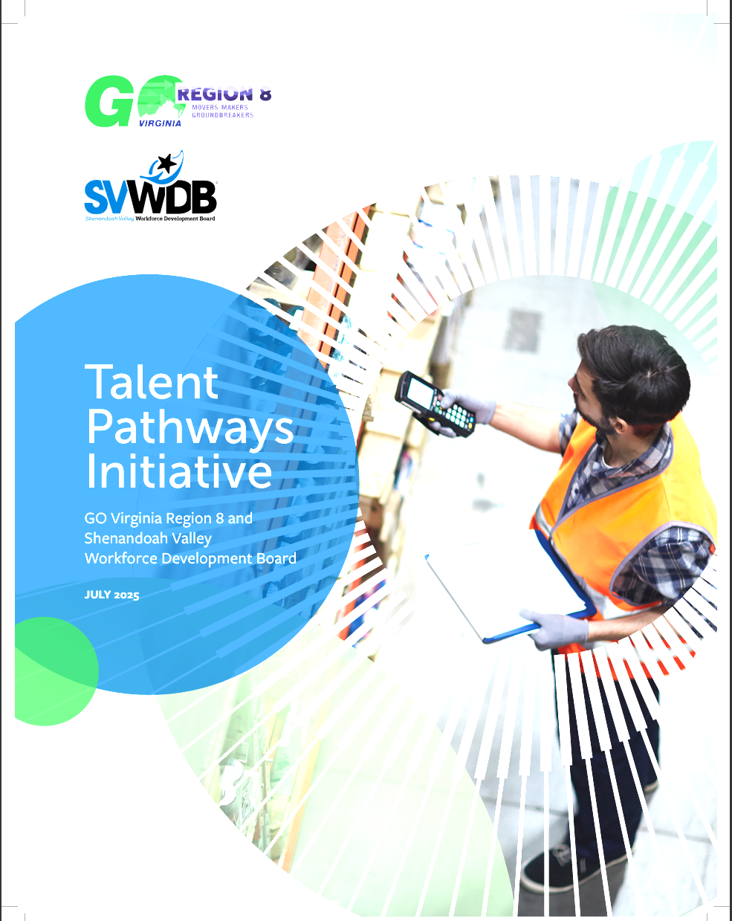
Talent Pathways Initiative Efforts Update
SVWDB met in September
Three Implementation Projects were identified (Phase I)
First Project: Create Region 8 Manufacturing Industry Consortium
Second Project: Create an Essentials Skills Credential/Badge Program
Third Project: Create Region 8 Transportation & Logistics Industry Consortium
Community Follow-up Virtual Meeting: October 30, 2025 @ 2pm
Link available on GoVaR8 Events Webpage & FB/LinkedIn Channels

Slide 9


Slide 10
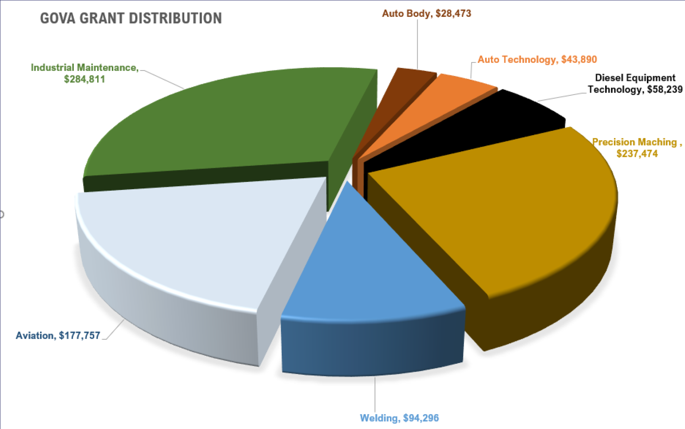

Slide 11
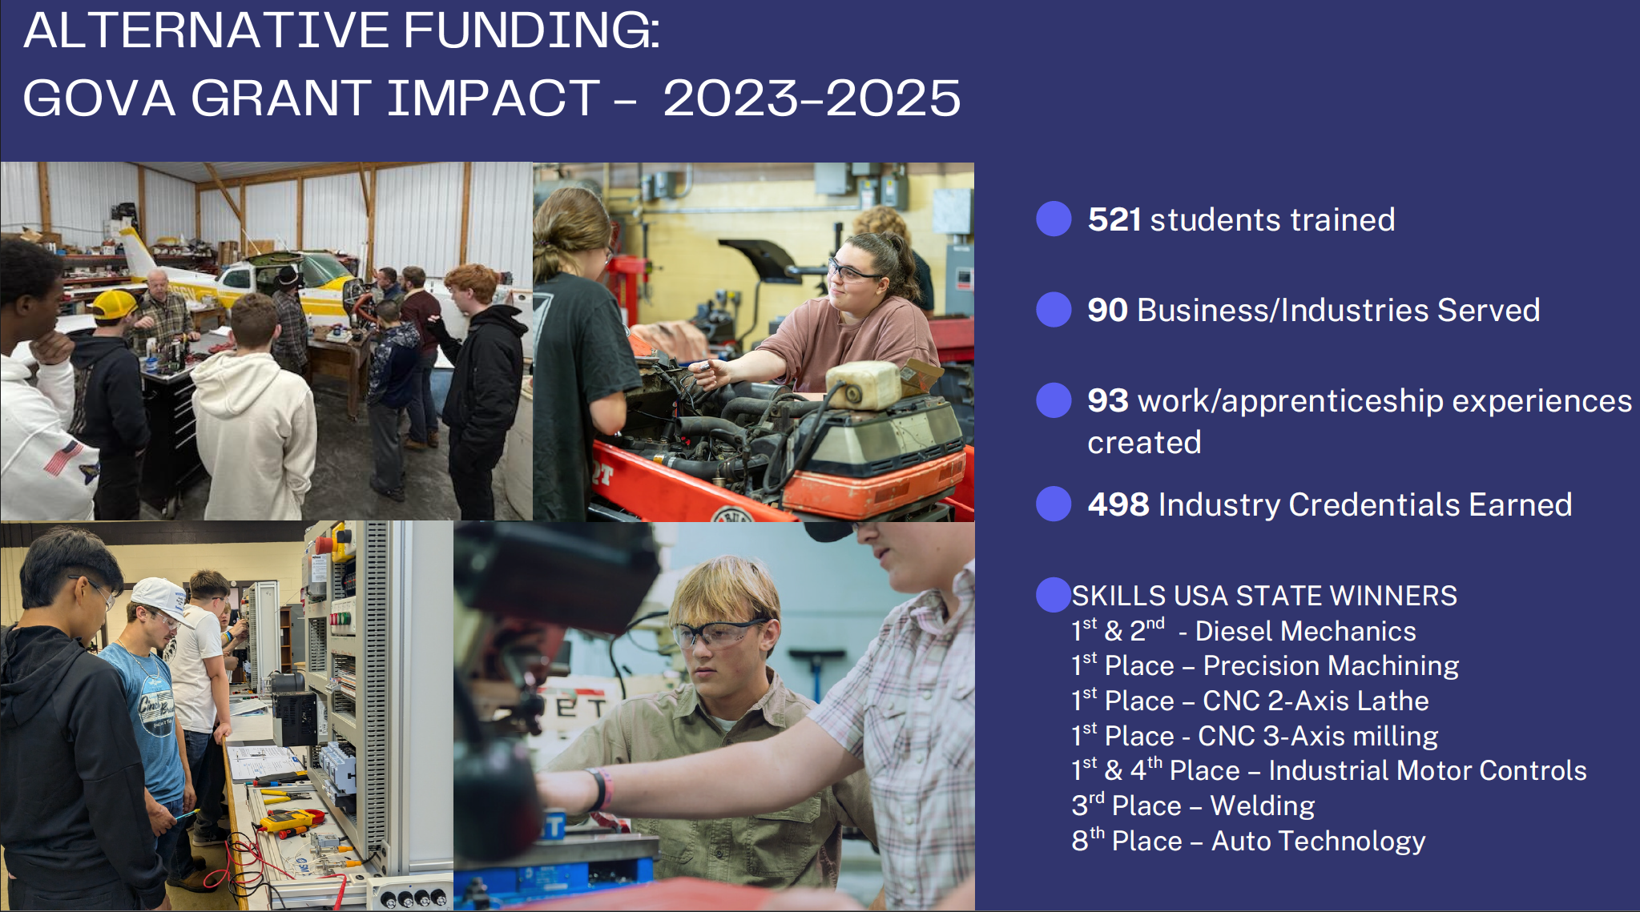

Slide 12
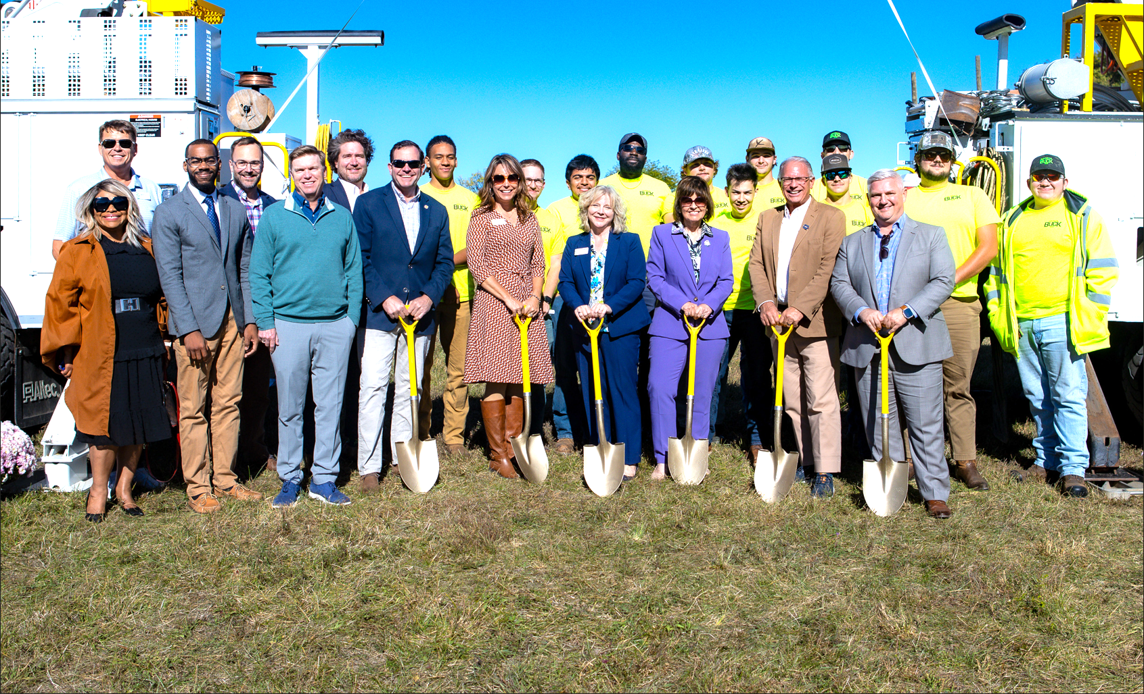
Laurel Ridge Community College: Expressways to Power Groundbreaking

Slide 13
